Slide 1

Smart Predictive Modeling for Rental Property Prices
To develop a data-driven model that predicts the rental price of residential properties based on relevant features.

Slide 2
Dataset Description
In the real estate industry, determining the appropriate rental price for a property is crucial for property owners, tenants, and property management companies. Accurate rent predictions can help landlords set competitive prices, tenants make informed rental decisions, and property management companies optimize their portfolio management.
The goal of this project is to develop a data-driven model that predicts the rental price of residential properties based on relevant features. By analyzing historical rental data and property attributes, the model aims to provide accurate and reliable rent predictions.
Attributes | Values
ID | A unique identifier for each property listing.
Type | The type of property, such as BHK1, BHK2, RK1, etc.
Locality | The specific neighborhood or area where the property is located.
Lease Type | The type of lease, such as FAMILY or BACHELOR, or ANYONE
Gym | Indicates whether the property has a gym or fitness facility.

Slide 3
Dataset Description
Attributes | Values
Activation Date | The date when the property listing was activated or made available for rent.
Latitude | The geographic latitude coordinate of the property's location.
Longitude | The geographic longitude coordinate of the property's location.
Lift | Indicates whether the property has an elevator or lift.
Swimming Pool | Indicates whether the property has a swimming pool
Negotiable | Indicates whether the rent price is negotiable.
Furnishing | Describes the level of furnishing, e.g., fully furnished, partially furnished, unfurnished.
Parking | Specifies the availability of parking facilities.
Property Size | The size of the property in terms of square footage or square meters.
Property Age | The age of the property since construction.

Slide 4
Dataset Description
Attributes | Values
Bathroom | The number of bathrooms available in the property.
Facing | The direction in which the property faces, e.g., north, south, east, west.
Cup board | Indicates the presence of cupboards or storage units.
Floor | The floor number on which the property is located.
Total Floor | The total number of floors in the building.
Amenities | Additional amenities or features provided with the property
Water Supply | The type and availability of water supply.
Building Type | The architectural style or type of building, e.g.,Apartment, Individual House
Balconies | The number of balconies or outdoor spaces.
Rent | The target variable, representing the rental price for the property.

Slide 5



Data Preprocessing Link to Preprocessing
1. Initial Dataset Overview:
Started with a dataset comprising 20,555 rows and 25 columns.
2. Handling Missing Values:
Identified missing values in 17 columns.
Adopted a strategy of imputing missing values:
Utilized 'fillna' with mean, median, or mode for relevant columns.
Opted to drop NA values for columns deemed unnecessary for analysis.
3. Data Type Transformation:
Recognized the significance of the activation date column.
Transformed the data type of the 'object' column to 'date' for the activation date, facilitating time-based analysis.

Slide 6
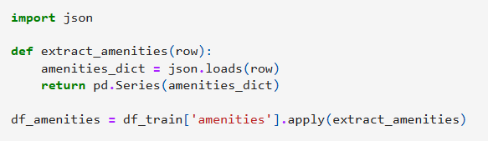

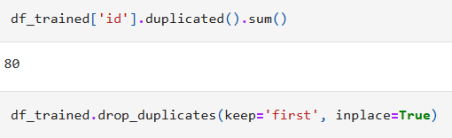
Data Preprocessing Link to Preprocessing
4. Processing Amenities Information:
Focused on leveraging the amenities column, initially in JSON format.
Strategically split the amenities data into separate columns.
Crafted a method to extract meaningful insights from the amenities JSON file, creating distinct columns for each amenity.
5. Concatenation and Final Feature Count:
Consolidated the newly derived amenities columns with the existing dataset.
Achieved a resultant dataset with an expanded feature set, now comprising a total of 43 columns.
6. Addressing Data Quality:
Uncovered and addressed 80 duplicated records within the dataset.
Eliminated duplicate values to enhance data integrity, ensuring a clean dataset for modeling.

Slide 7
Feature Selection Methods Employed Link to Preprocessing
Correlation Analysis:
Utilized correlation analysis to gauge the relationship between variables.
Highlighted the identification of features highly correlated with the target variable (rent price) and each other.
Emphasized the selection of features with strong correlations, aiding in predictive accuracy while minimizing multicollinearity.
Iterative Refinement and Validation:
Iteratively refined the feature set based on the performance metrics of various models.
Stressed the importance of cross-validation and evaluation metrics to validate the selected features' contribution to model performance.
Mentioned any specific challenges encountered during the feature selection process and how they were addressed.

Slide 8

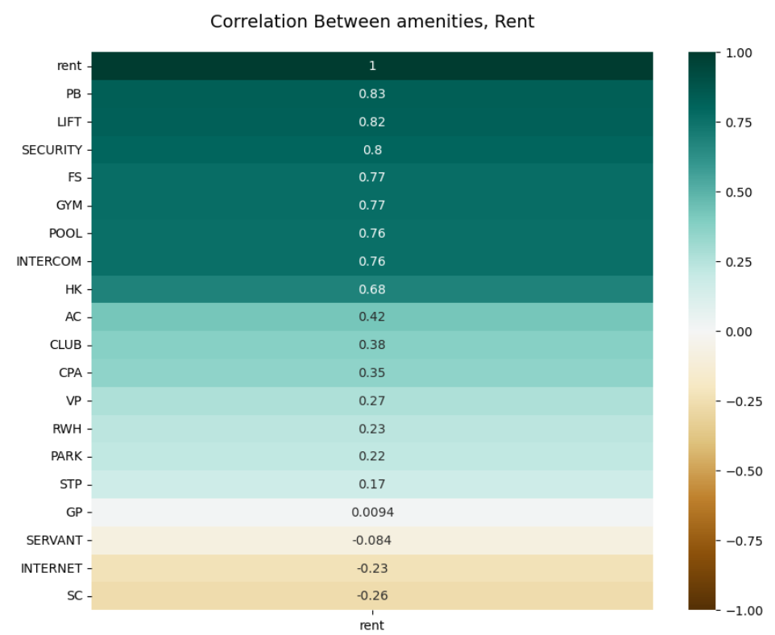
Exploratory Data Analysis (EDA) Insights Link to Insights
1. Foundation of Analysis:
Highlight the importance of EDA in establishing a robust foundation for predictive modeling.
2. Analysis Questions Explored:
Present the key analysis questions addressed during EDA (as mentioned in your list).
For each question, briefly discuss the findings and insights discovered from the data.
3. Correlation Analysis:
Emphasize the correlations discovered:
Relationships between bedrooms, bathrooms, property size, and rent prices.
Impact of amenities on rent prices.
4. Geospatial Analysis:
Showcase spatial insights:
Regions with higher rent prices.
Correlation between location coordinates and rent prices.

Slide 9
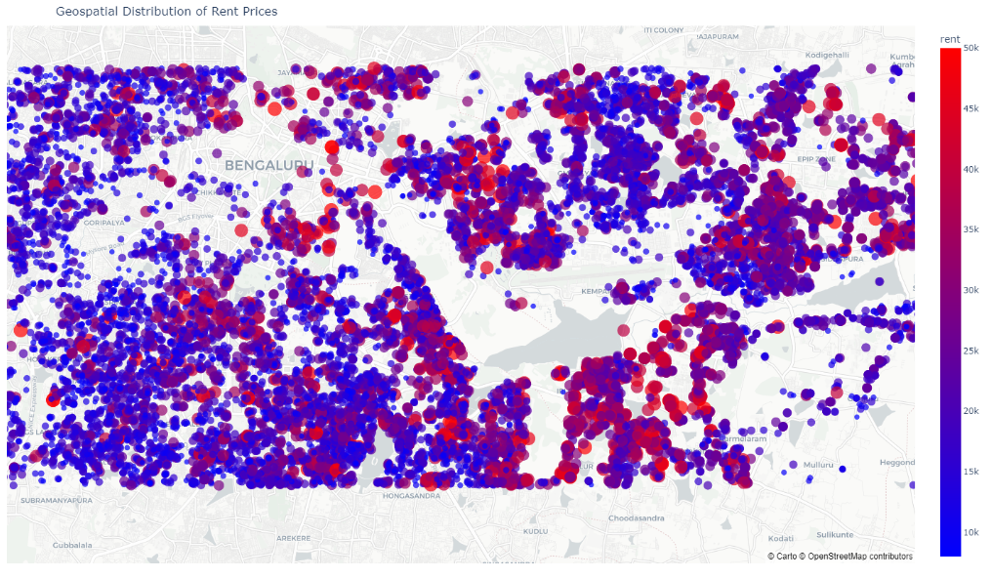
Exploratory Data Analysis (EDA) Insights Link to Insights
5. Temporal Analysis:
Highlight temporal trends:
Trends in rent prices based on activation date.
Relationship between property age and rent prices over time.
6. Property Features and Rent:
Discuss insights related to property features:
Influence of specific amenities and furnishing levels on rent prices.
Effect of floor levels and total floors in buildings on rent.
7. Negotiability, Balconies, and Amenities:
Present findings on:
Impact of negotiable versus fixed rent prices.
Relationship between balconies, facing direction, and rent prices.
Influence of various amenities on rent.
Different building types on rent.

Slide 10
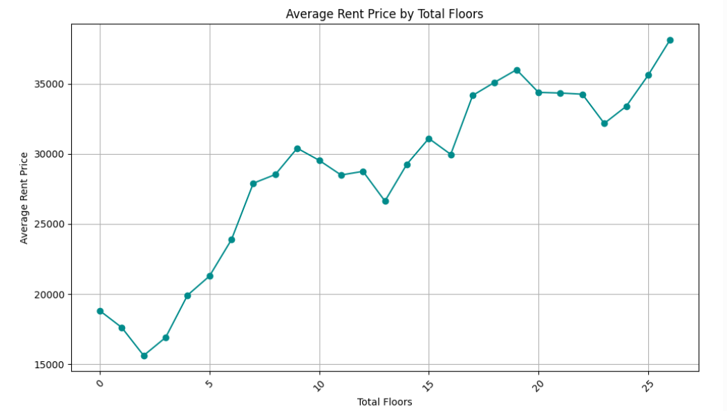
Exploratory Data Analysis (EDA) Insights Link to Insights
8. Water Supply and Building Type:
Discuss the influence of:
Water supply types on rent prices.
9. Predictive Analysis Insights:
Summarize the feasibility and results of building a predictive model:
Mention the model's ability to estimate rent prices.
Highlight the most impactful features identified by the model.
10. Key Takeaways:
Sum up the most significant findings and insights gleaned from the EDA process.
Discuss any challenges faced or unexpected discoveries during the analysis.
Conclusion:
Conclude by emphasizing the importance of EDA in shaping the understanding of rent price determinants and paving the way for accurate predictive modeling.

Slide 11
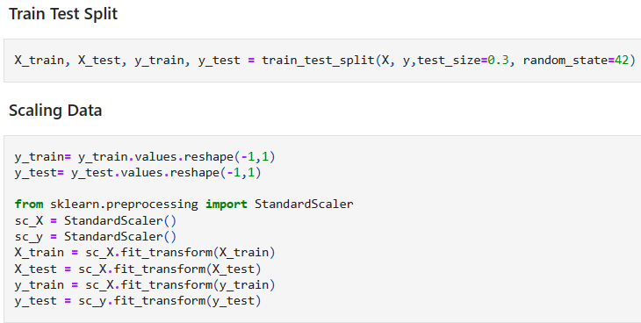
Model Selection, Training, and Evaluation: Link to Model section
1. Regression Algorithms Considered:
Enumerate the regression algorithms explored:
Linear Regression, Decision Trees, Random Forests, Gradient Boosting, Neural Networks.
Highlight the rationale behind choosing these algorithms for their suitability in predicting house rent prices.
2. Model Exploration Strategies:
Mention approaches like ensembling or stacking multiple models for potential performance enhancement.
Briefly discuss the advantages of ensemble techniques in improving predictive accuracy.
3. Model Training and Data Splitting:
Describe the dataset splitting into training and testing sets:
Emphasize the division ratio used (e.g., 80% training, 20% testing).
Indicate any specific considerations made while splitting the data.
4. Training and Evaluation Process:
Outline the steps taken to train the selected models using the training data.
Highlight the evaluation metrics employed (e.g., Mean Squared Error, Mean Absolute Error) to assess model performance.
Mention any hyperparameter tuning or cross-validation techniques utilized to optimize model performance.

Slide 12
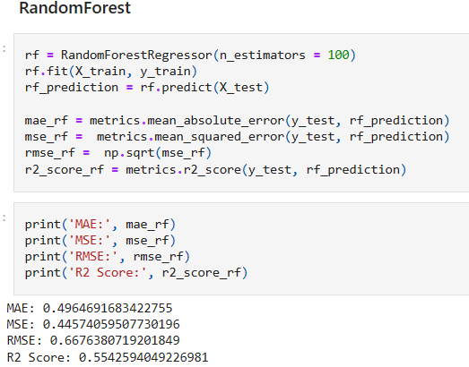
Model Selection, Training, and Evaluation: Link to Model section
5. Model Performance Results:
Present a summary of the performance metrics for each model evaluated on the testing data.
Highlight the model(s) that performed best based on the chosen evaluation metrics.
6. Final Model Selection:
Discuss the rationale behind selecting the best-performing model(s) for rent price prediction.
Explain why the chosen model(s) outperformed others and their suitability for the task.
7. Future Considerations:
Briefly touch upon potential next steps:
Any possibilities for further model refinement or exploration.
Considerations for deploying the selected model in a real-world scenario.
Conclusion:
Summarize the model selection process and its significance in identifying the most effective approach for predicting house rent prices.

Slide 13
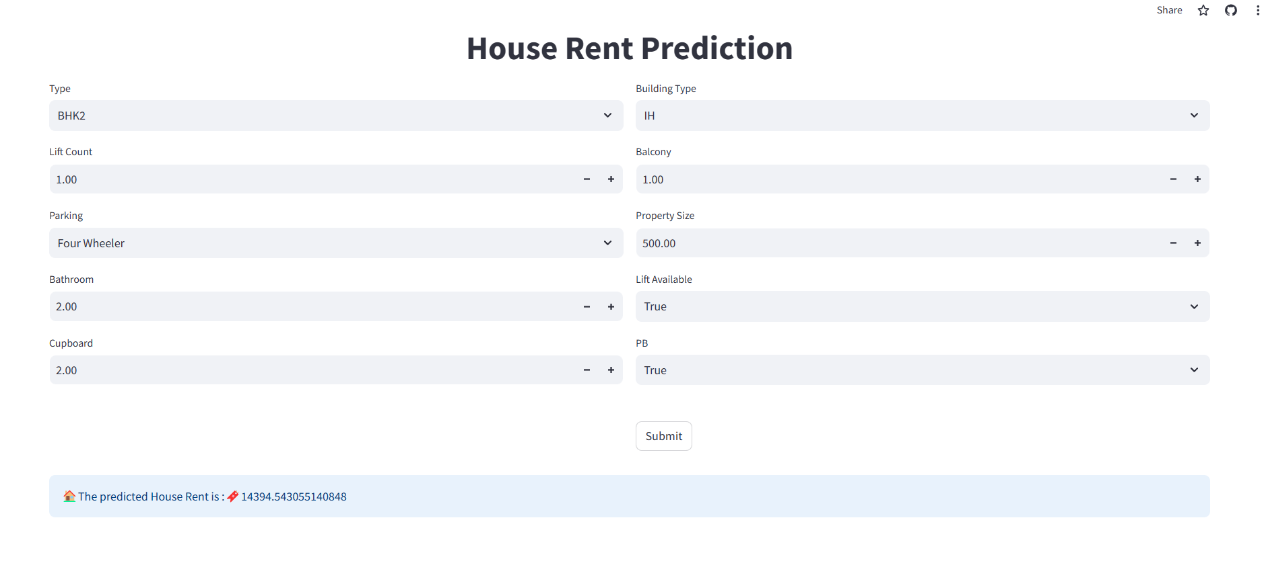
Hyperparameter Tuning, Interpretability, and Deployment:
1. Hyperparameter Tuning:
Discuss the process of fine-tuning model hyperparameters:
Gridsearch technique to fine-tune the models.
Emphasize the impact of optimized hyperparameters on the model's predictive capability.
2. Interpretability and Feature Importance:
Highlight the analysis conducted for feature importance:
Describe methods employed (e.g., feature importance from tree-based models).
Showcase key insights into the factors that significantly influence rental prices.
Explain the importance of understanding these features for stakeholders or end-users.
3. Model Deployment using Streamlit: Link
Discuss the deployment strategy using Streamlit for creating a user-friendly web application:
Explain the choice of Streamlit as the deployment platform for its ease of use and interactive features.
Describe the functionalities incorporated in the web application for end-users.
Mention any specific challenges faced during the deployment process and how they were addressed.

